Slide 1
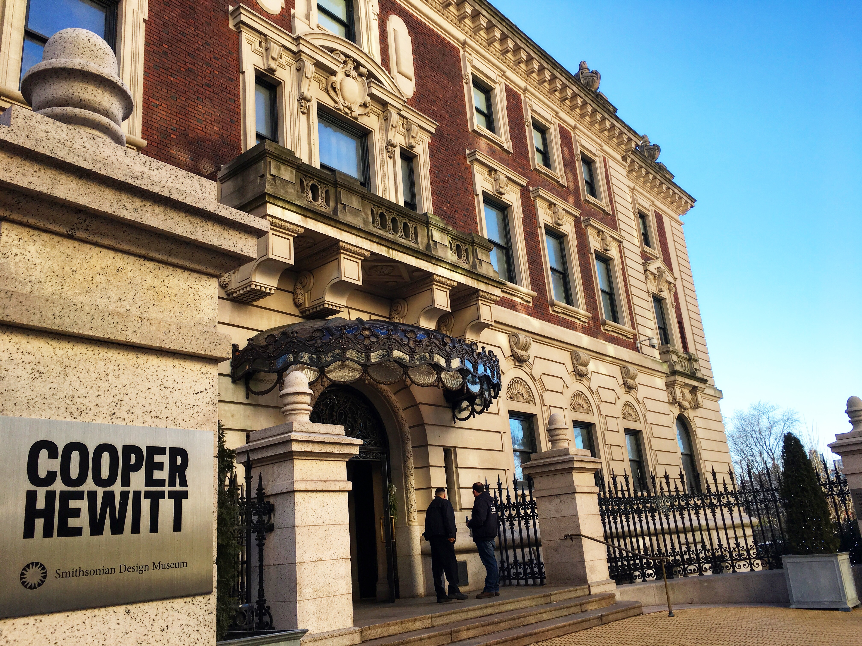
Cooper Hewitt Smithsonian Design Museum
January 25, 2018

Slide 2
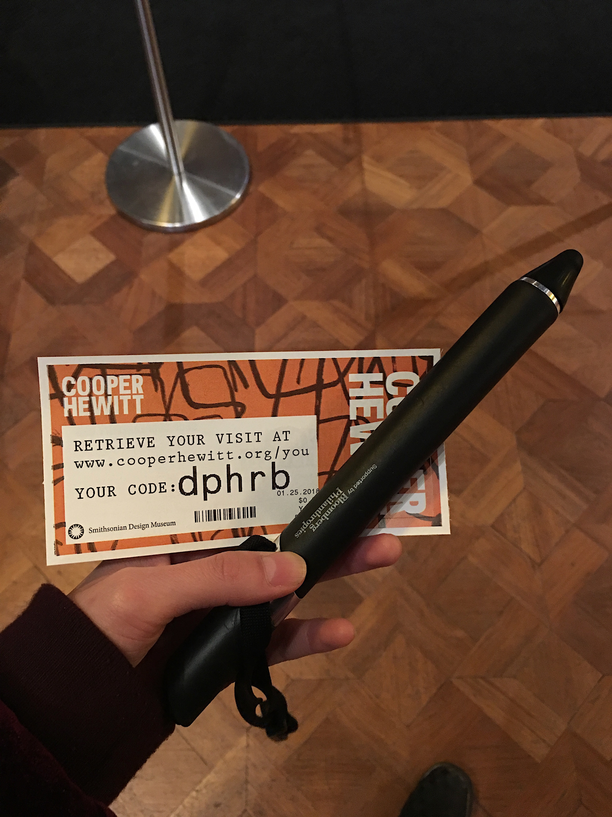
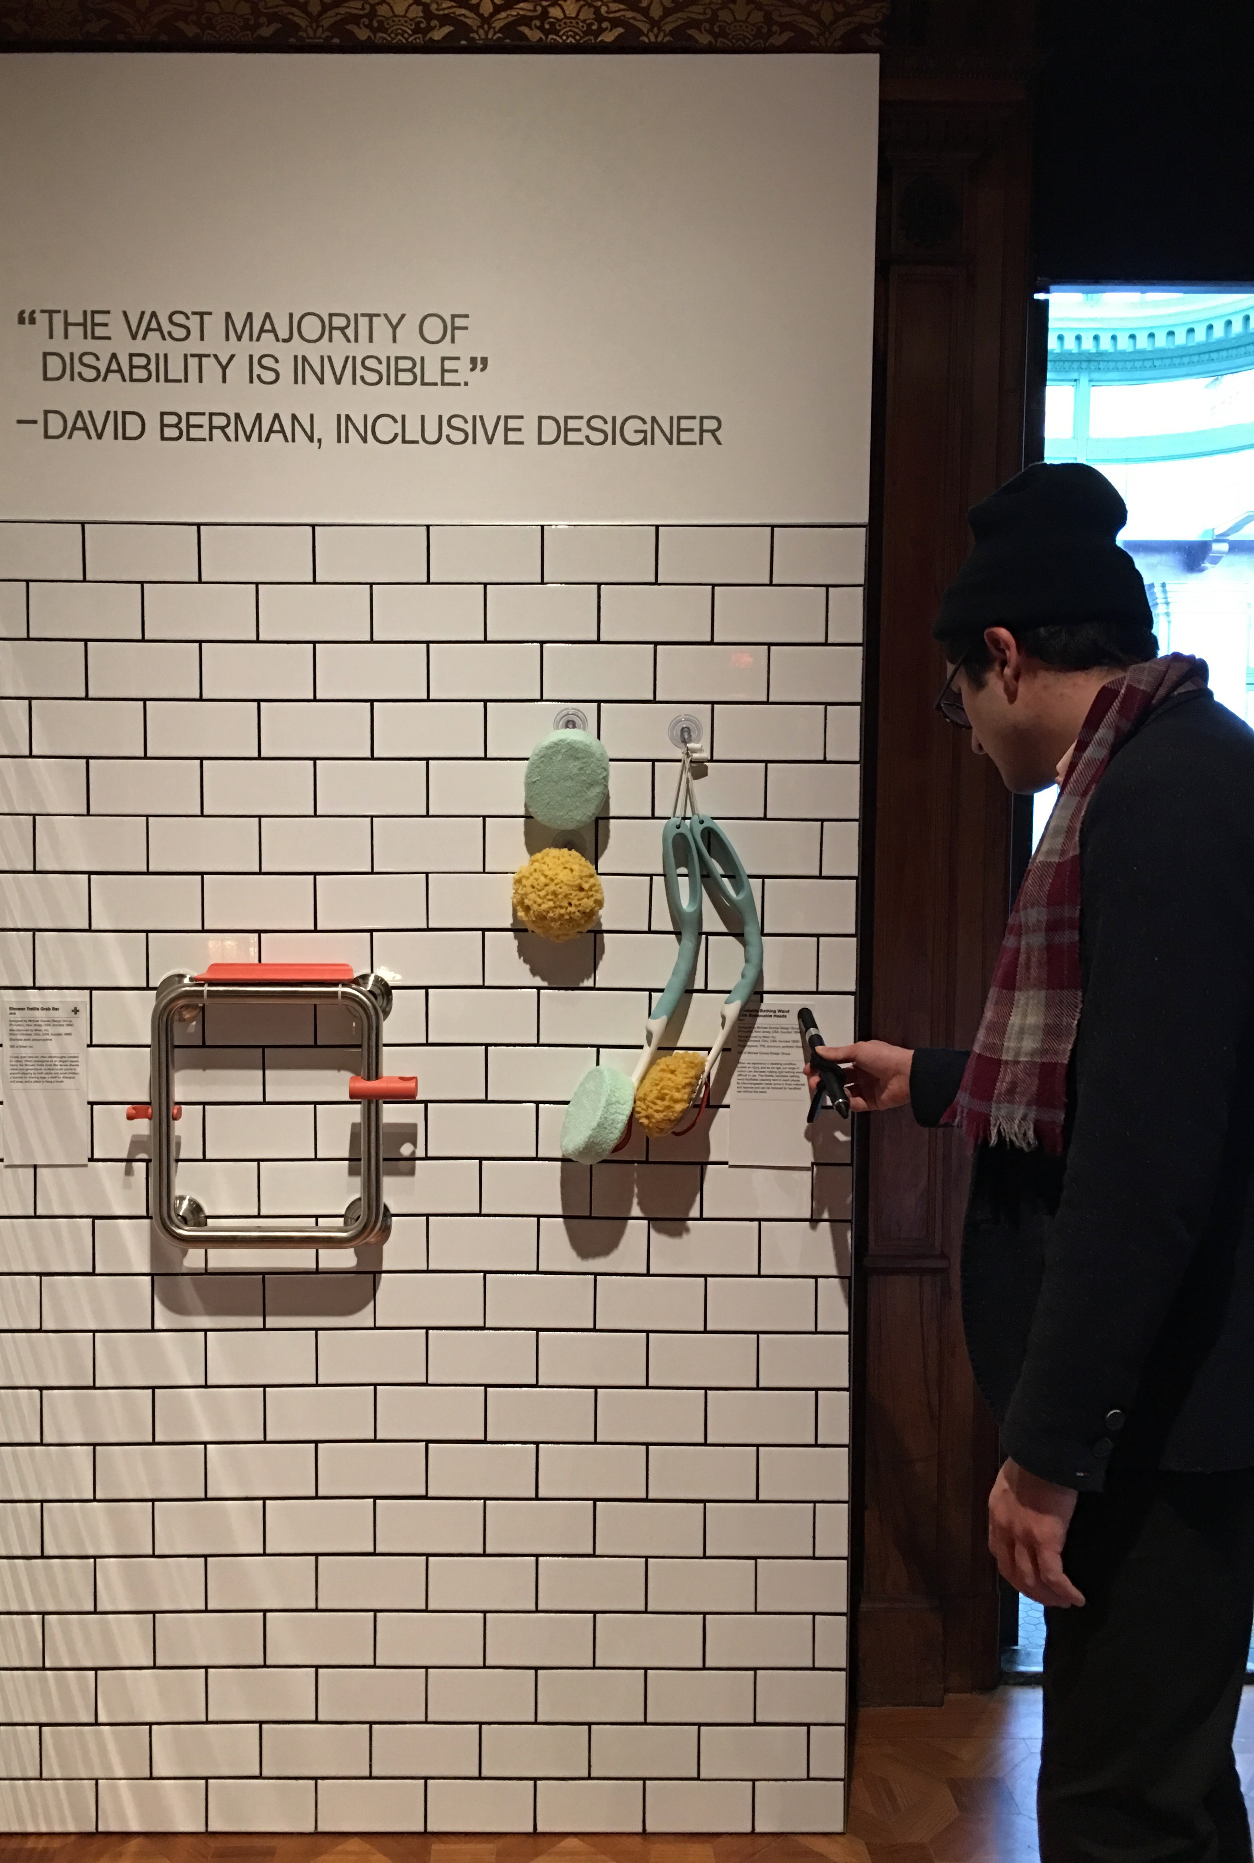
Spatial + Digital Interaction

Slide 3
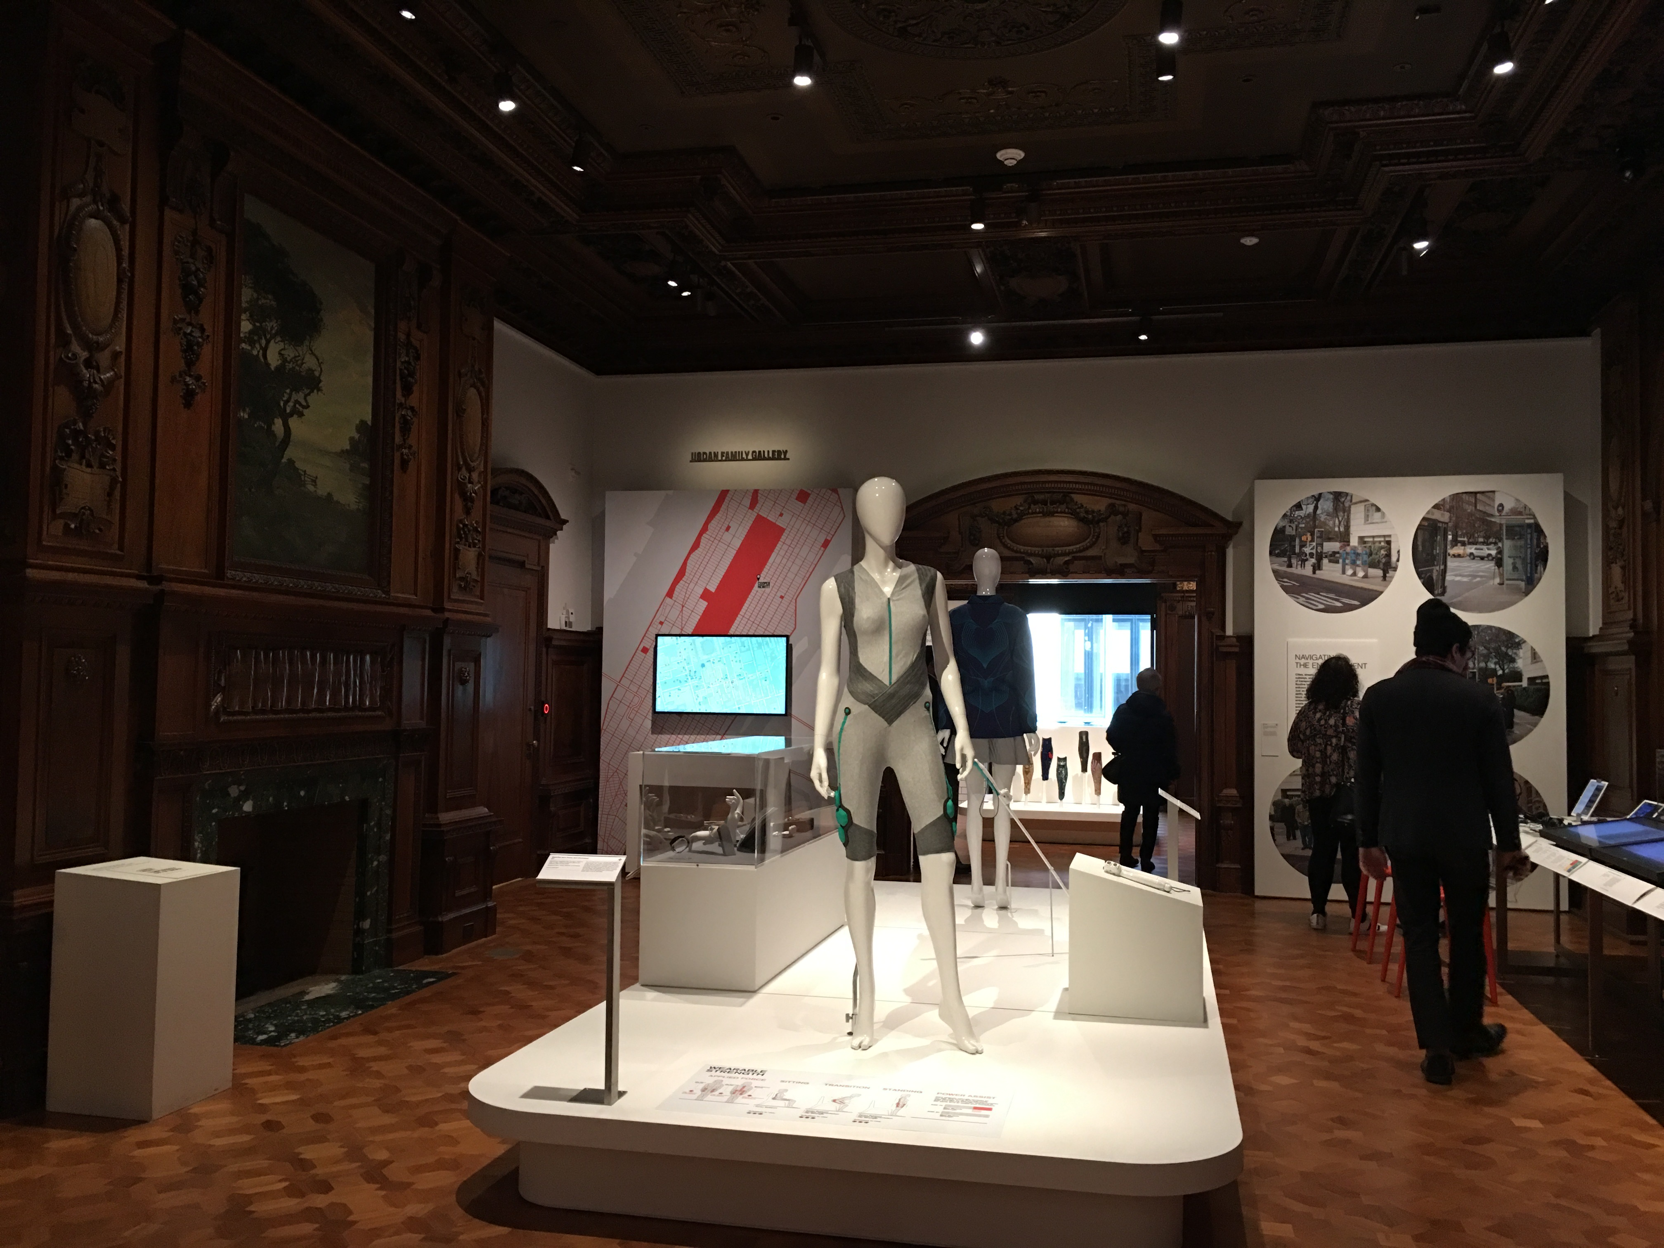
Access + Mobility Exhibit
Visual
Audio
Textual
Interactive
Kinetic

Slide 4
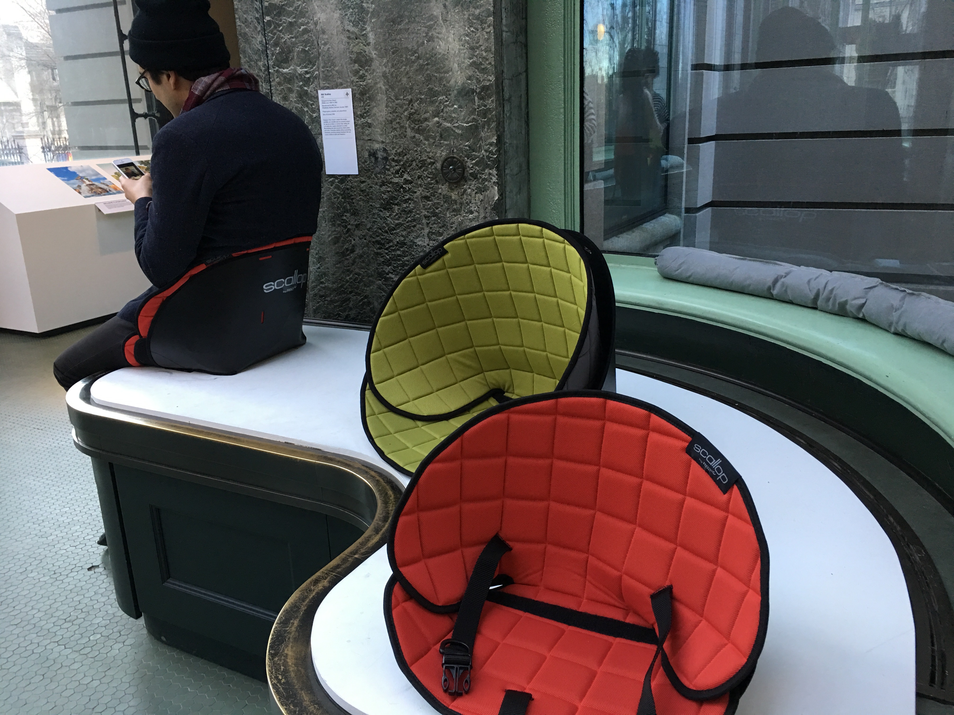
Access + Mobility Exhibit
Visual
Audio
Textual
Interactive
Kinetic

Slide 5
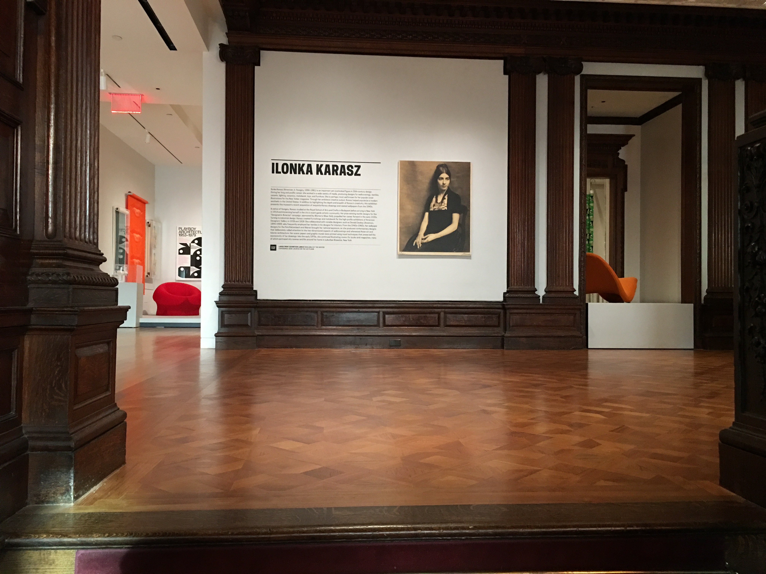
Historical Decorative Designer Exhibit

Slide 6
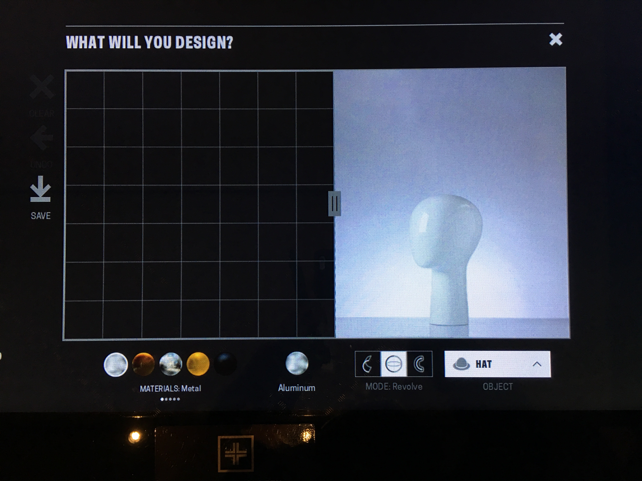
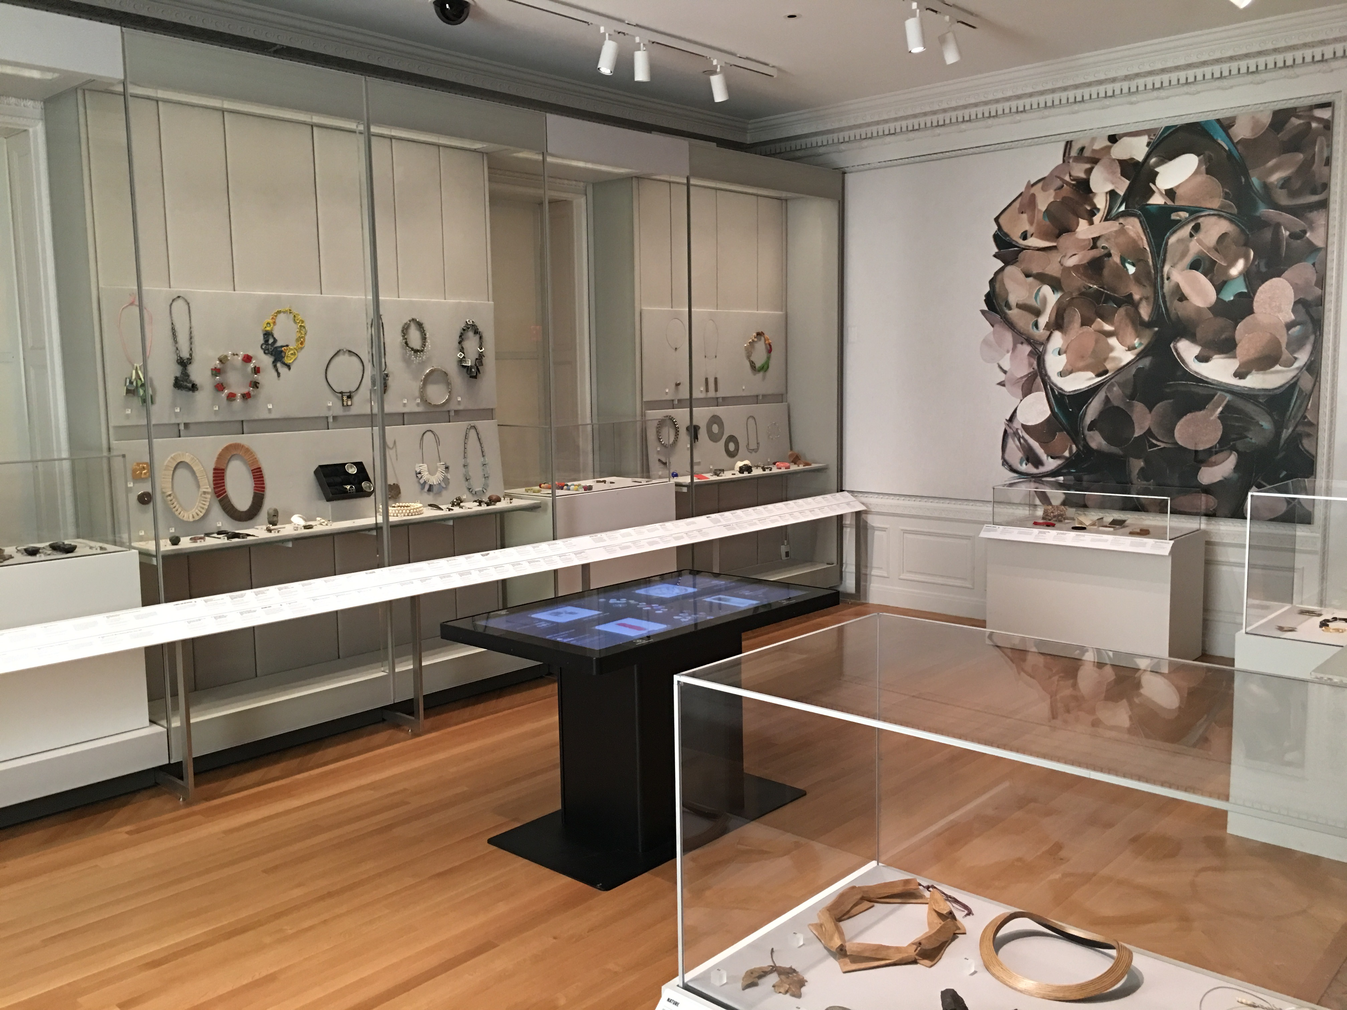
Ilonka Karasz & Historical Curations
Digital design / mood boards inspired by objects in the collection

Slide 7
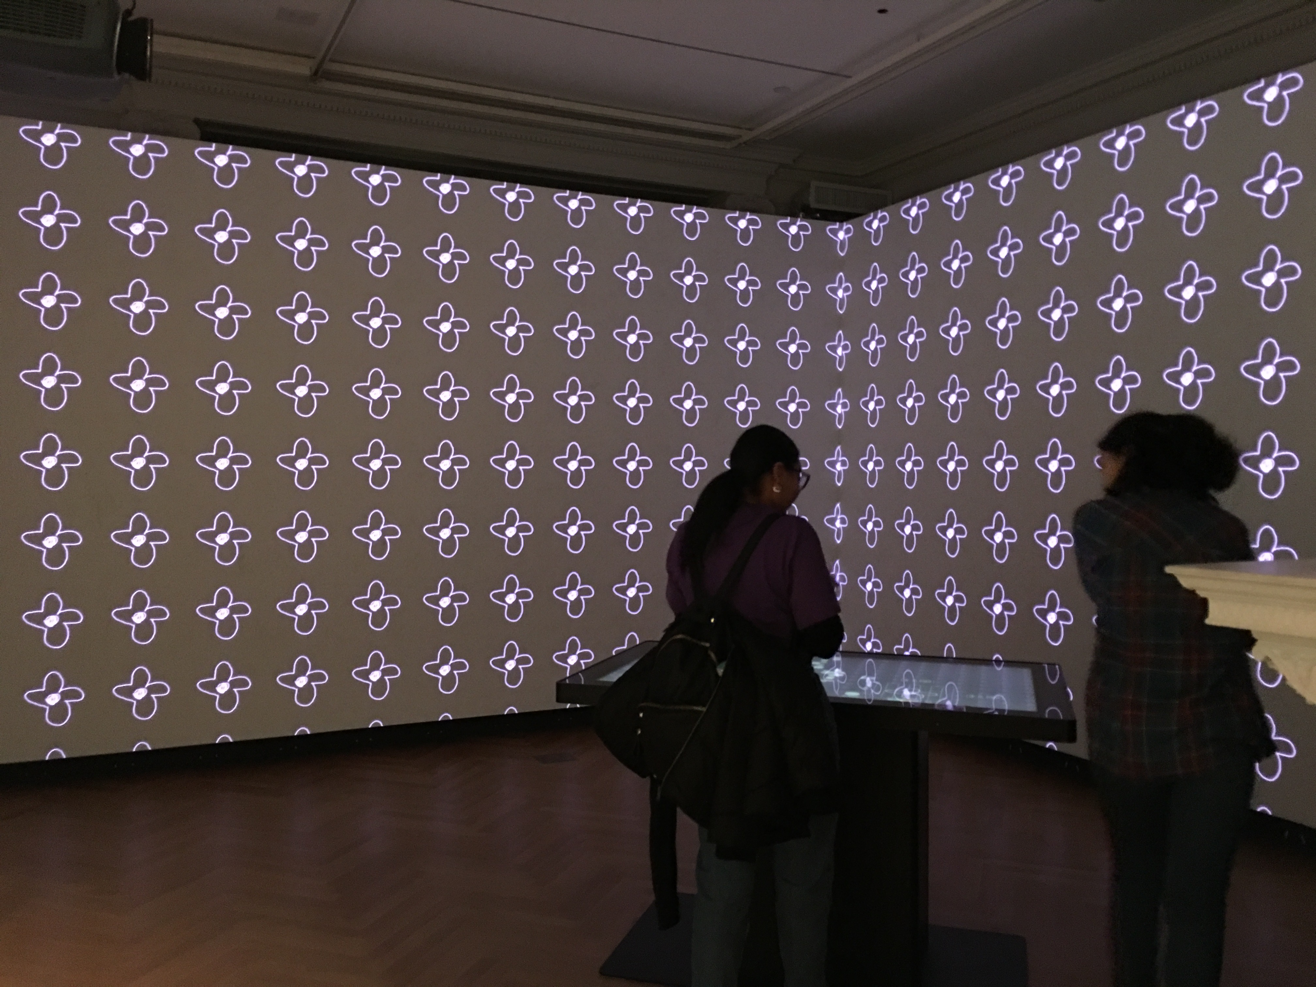
Historical Decorative Designer Exhibit
Immersive wallpaper room

Slide 8
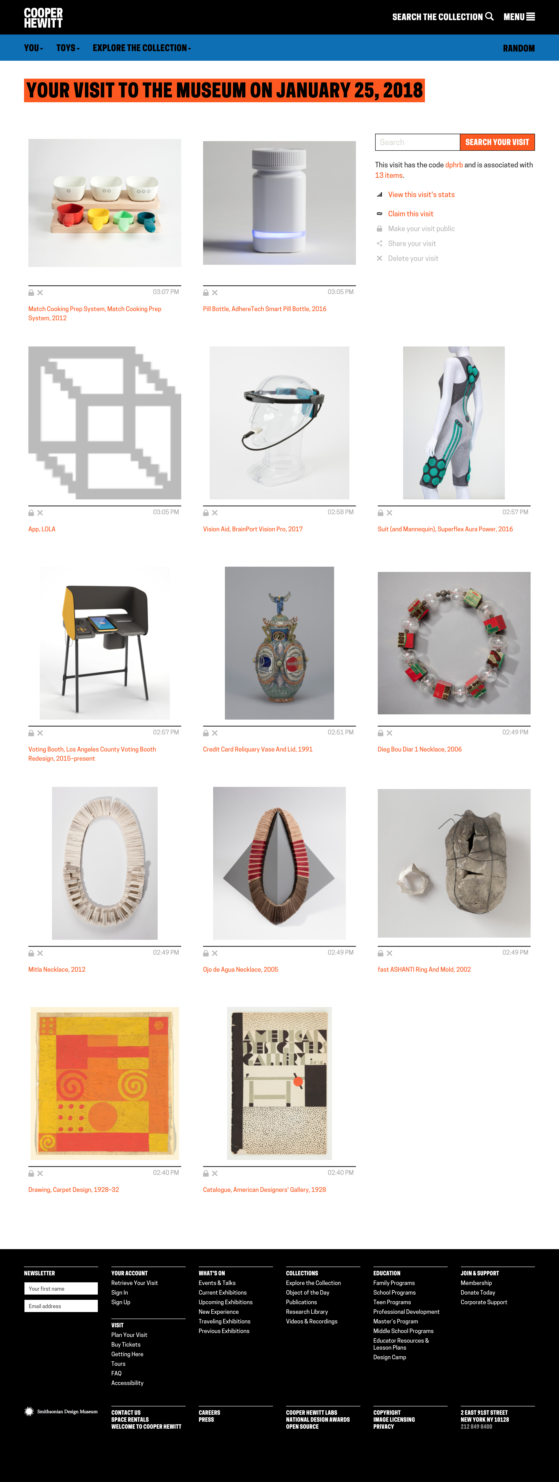
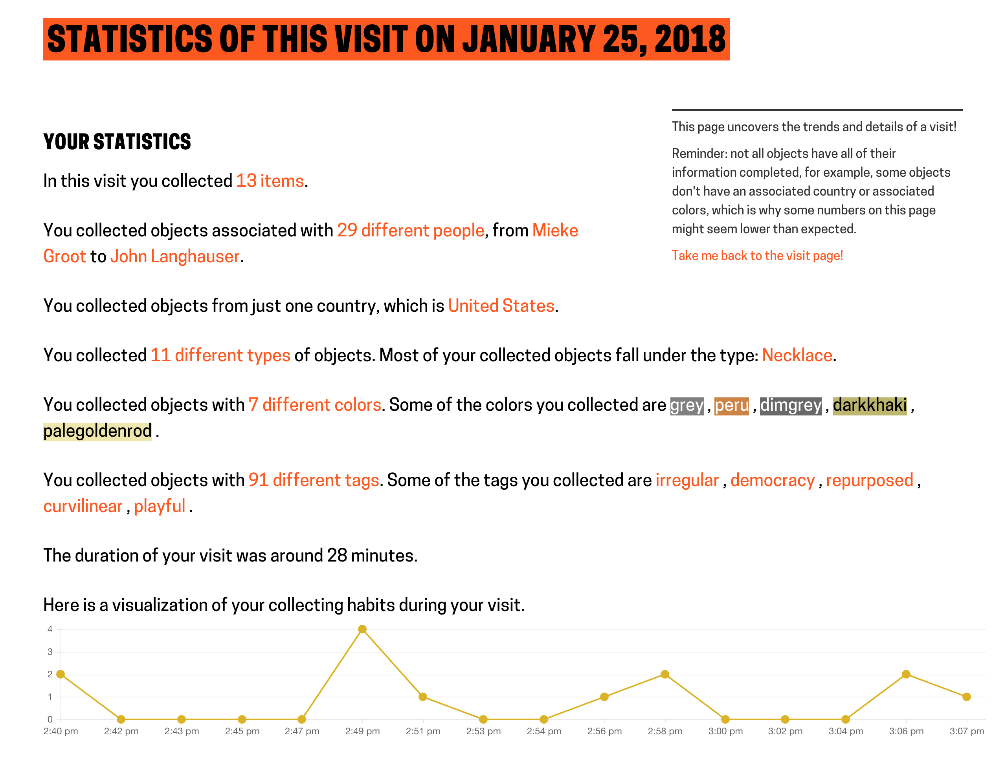
Online Reference

Slide 9
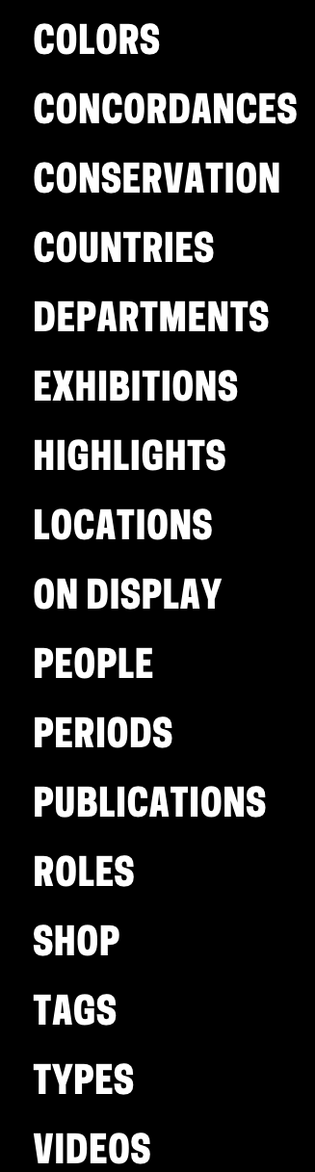
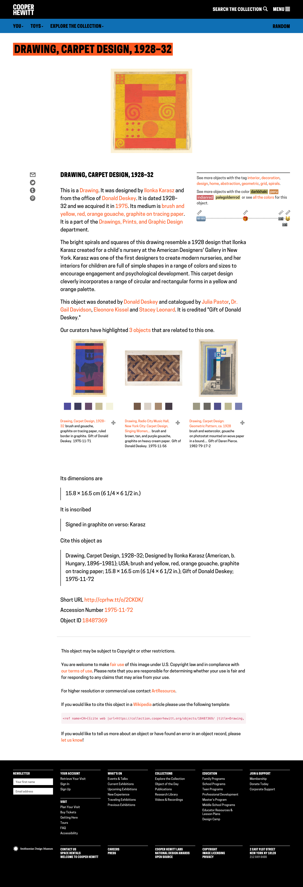
Online Reference

